Slide 1



A-SDF: Learning Disentangled Signed Distance Functions
for Articulated Shape Representation
Jiteng Mu, Weichao Qiu, Adam Kortylewski,
Alan Yuille, Nuno Vasconcelos, Xiaolong Wang
UC San Diego, Johns Hopkins University

Slide 2
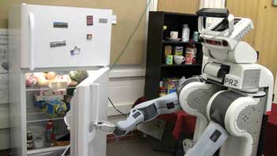
Motivation: representing general articulated objects
Open the refrigerator
Loper et al. SMPL: A Skinned Multi-Person Linear Model. ACM transactions on graphics (TOG), 2015.
Romero et al. Embodied hands: Modeling and capturing hands and bodies together. ACM Transactions on Graphics (TOG), 2017.
Image credit: https://www.photonics.com/Articles/Vision_helps_robots_help_you/a54525

Slide 3
Motivation: representing general articulated objects
Open the refrigerator
Modeling the articulated shape?
Loper et al. SMPL: A Skinned Multi-Person Linear Model. ACM transactions on graphics (TOG), 2015.
Romero et al. Embodied hands: Modeling and capturing hands and bodies together. ACM Transactions on Graphics (TOG), 2017.
Image credit: https://www.photonics.com/Articles/Vision_helps_robots_help_you/a54525

Slide 4
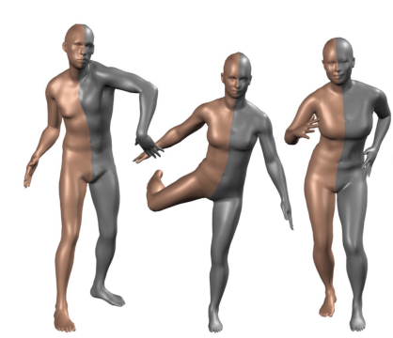
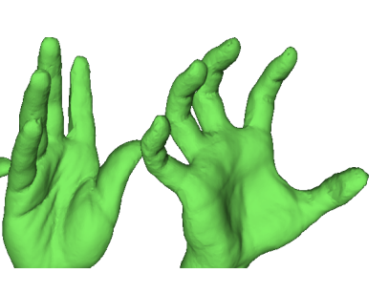
Motivation: representing general articulated objects
Parametric models
Open the refrigerator
Modeling the articulated shape?
SMPL
Loper et al., TOG 2015
MANO
Romero et al., TOG 2017
Loper et al. SMPL: A Skinned Multi-Person Linear Model. ACM transactions on graphics (TOG), 2015.
Romero et al. Embodied hands: Modeling and capturing hands and bodies together. ACM Transactions on Graphics (TOG), 2017.
Image credit: https://www.photonics.com/Articles/Vision_helps_robots_help_you/a54525

Slide 5
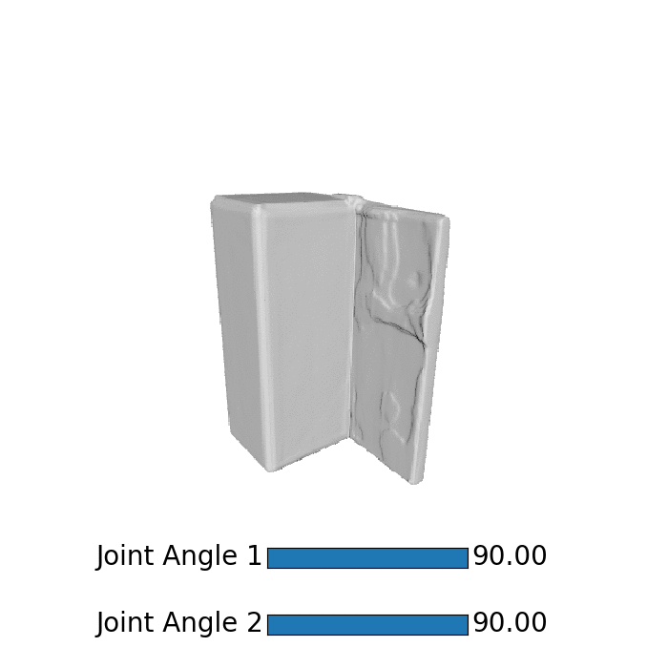
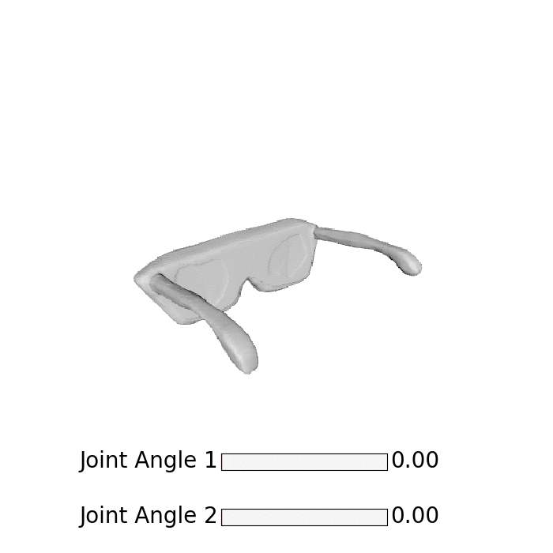
Motivation: representing general articulated objects
Parametric models for humans
Open the refrigerator
Modeling the articulated shape?
SMPL
Loper et al., TOG 2015
MANO
Romero et al., TOG 2017
General articulated objects?
Loper et al. SMPL: A Skinned Multi-Person Linear Model. ACM transactions on graphics (TOG), 2015.
Romero et al. Embodied hands: Modeling and capturing hands and bodies together. ACM Transactions on Graphics (TOG), 2017.
Image credit: https://www.photonics.com/Articles/Vision_helps_robots_help_you/a54525

Slide 6
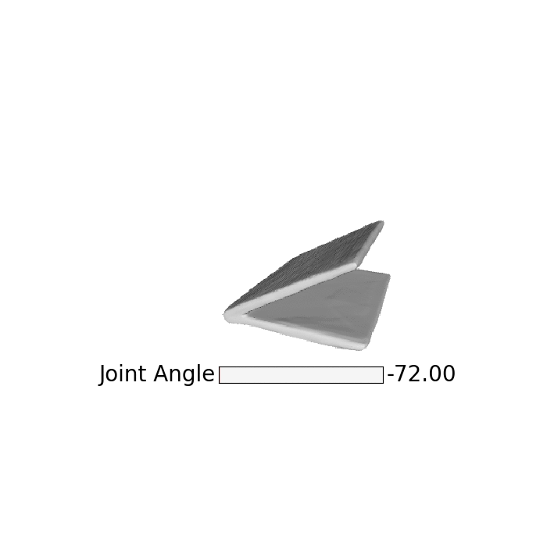
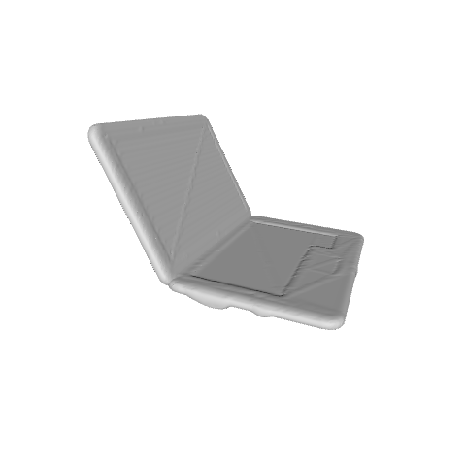
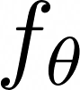
Highlight: a differentiable category-level articulated object representation
Given one shape, we can deform the shape by fixing the inferred shape code and only manipulating the articulation code (represented by joint angles).
Inferred Shape Code
Generated Shape
Input Shape
MLP
MLP
Joint Angle

Slide 7
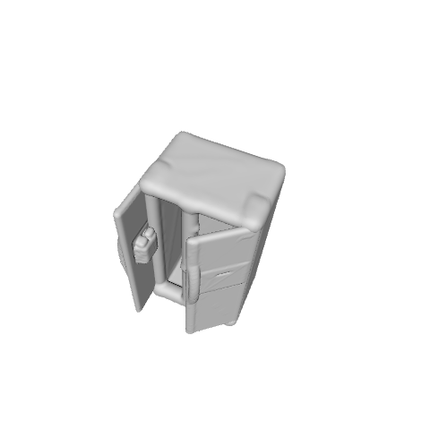
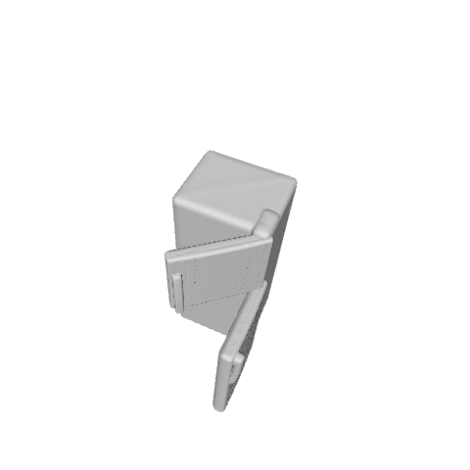
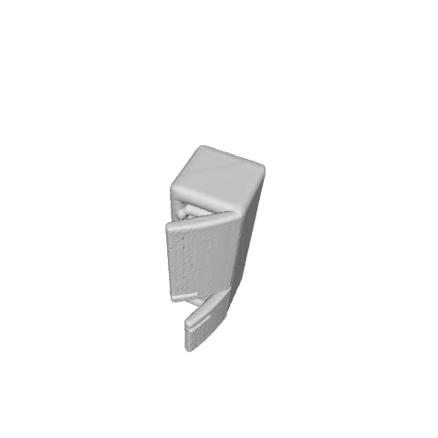
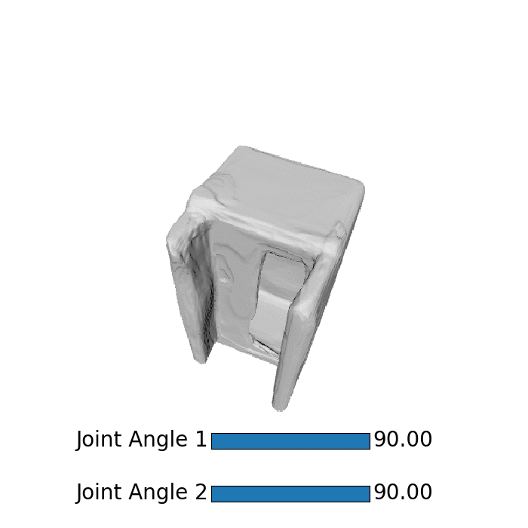
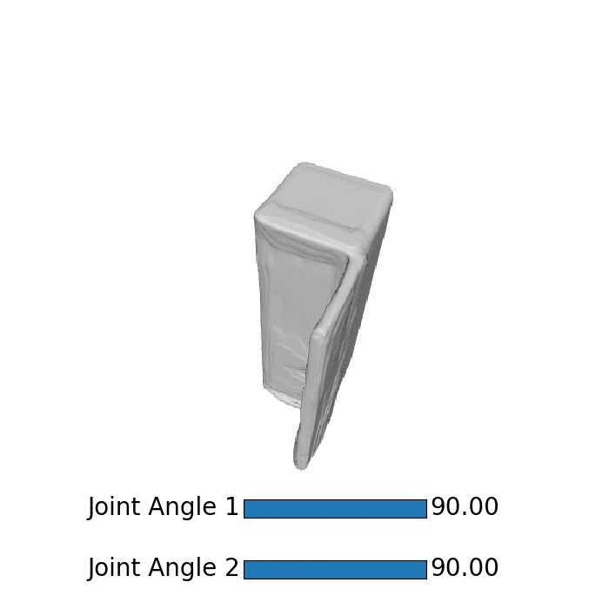
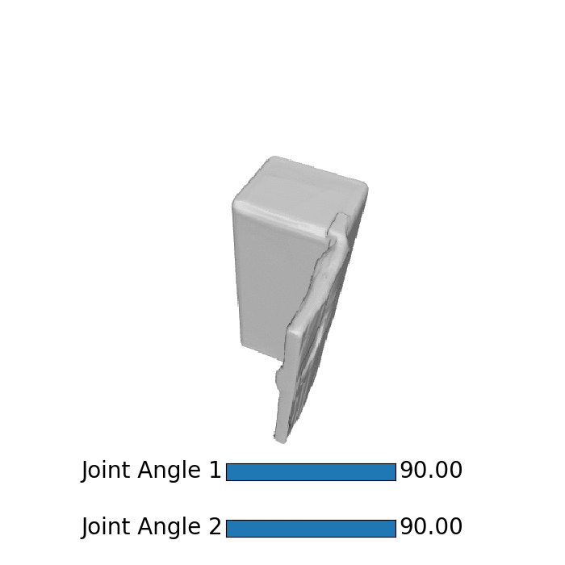
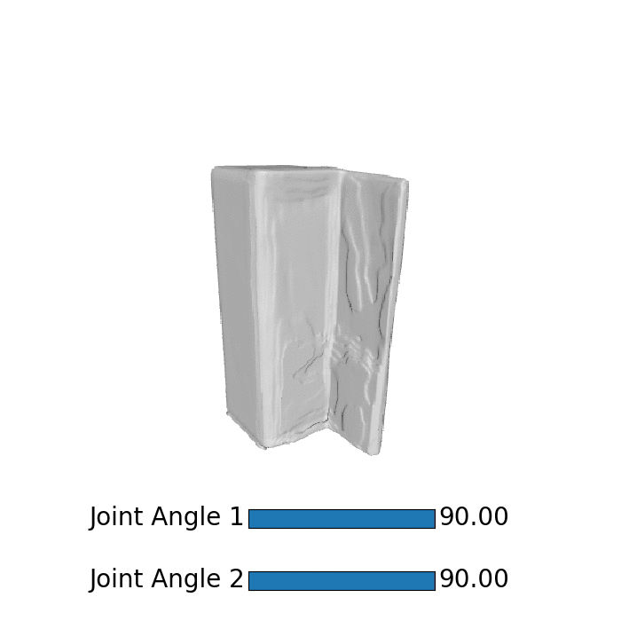
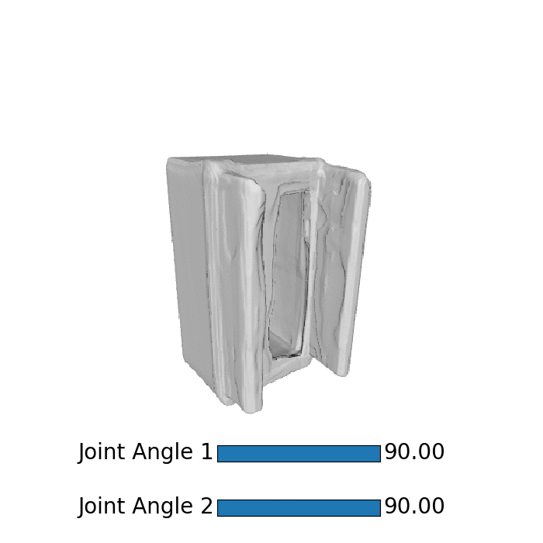
Input
View 1
Generation
View 2
Refrigerator

Slide 8
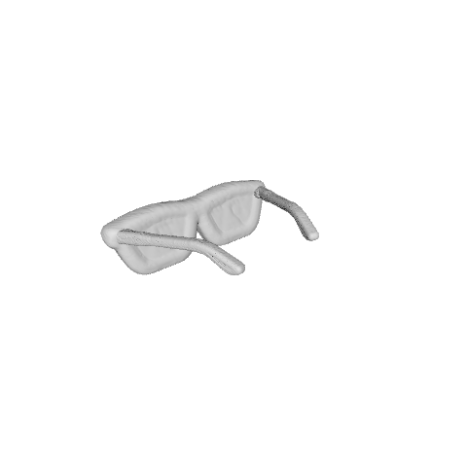
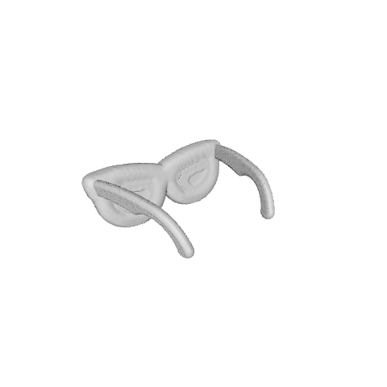
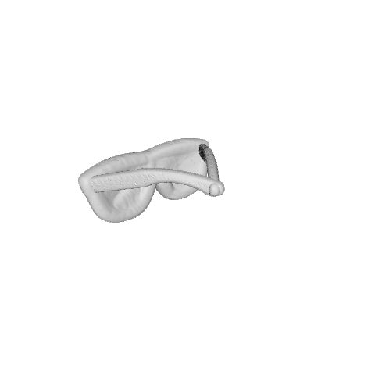
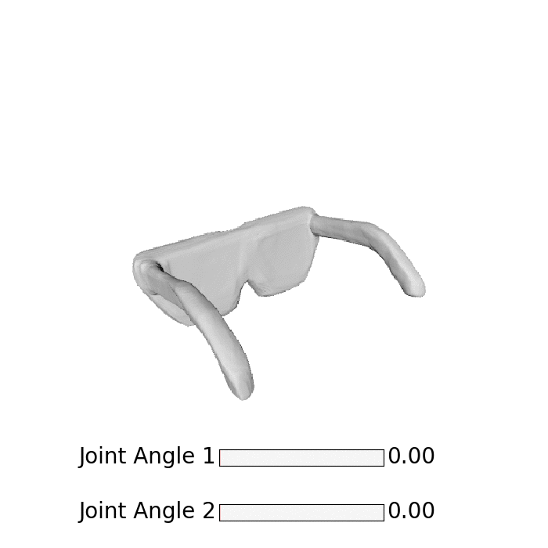
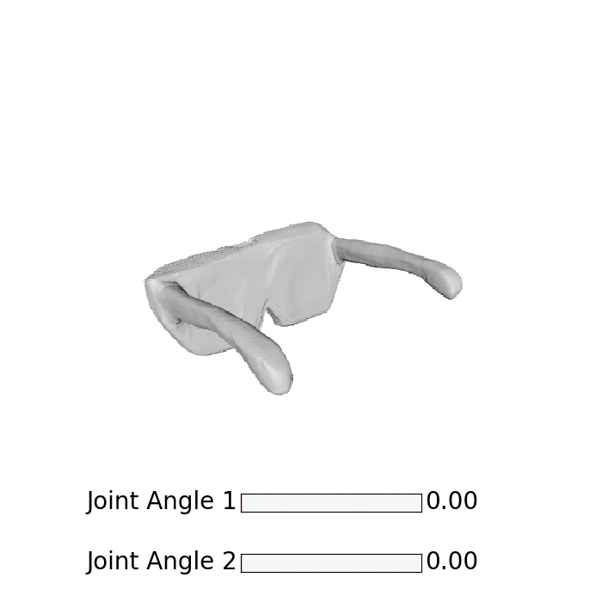
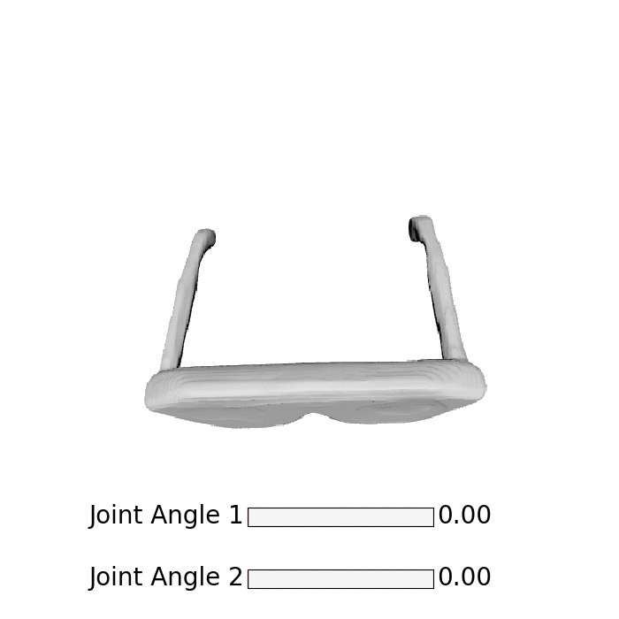
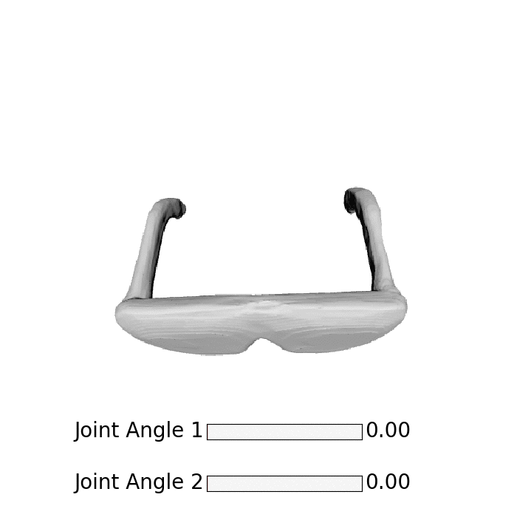
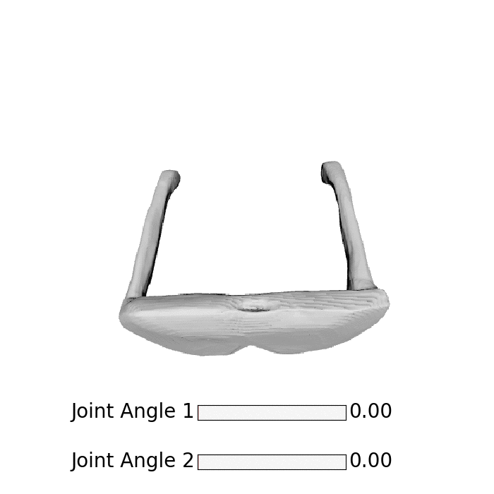
Input
View 1
Generation
View 2
Eyeglasses

Slide 9
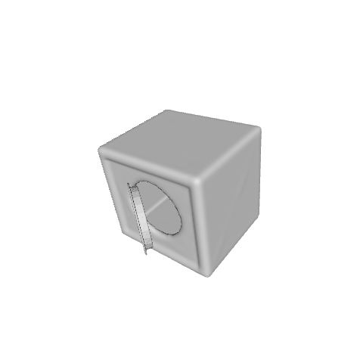
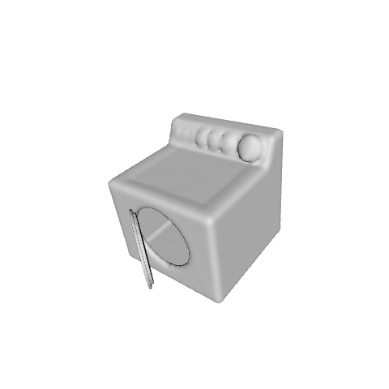
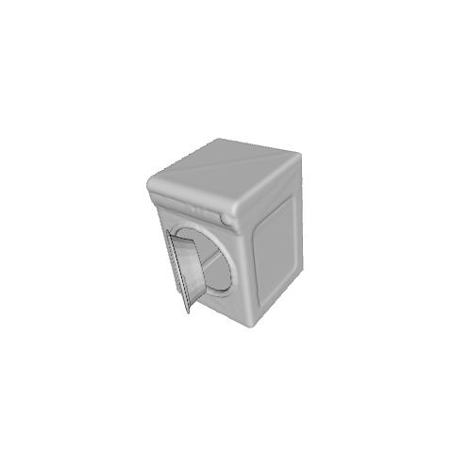
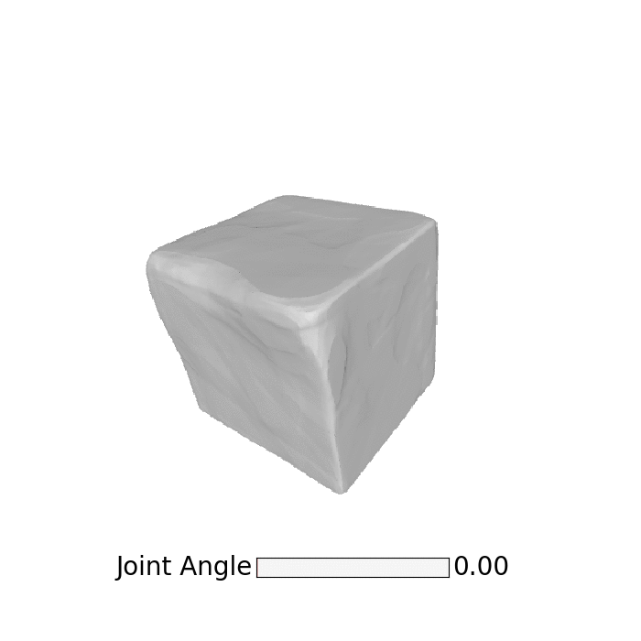
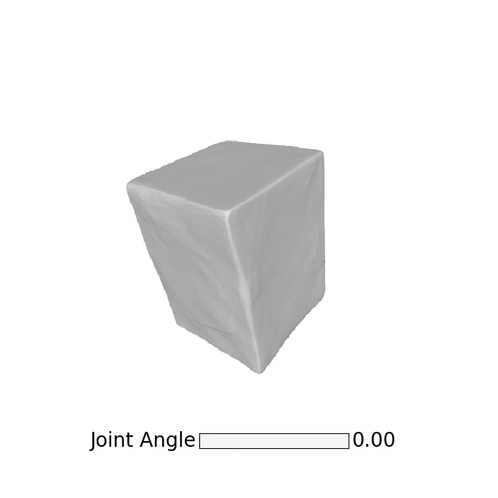
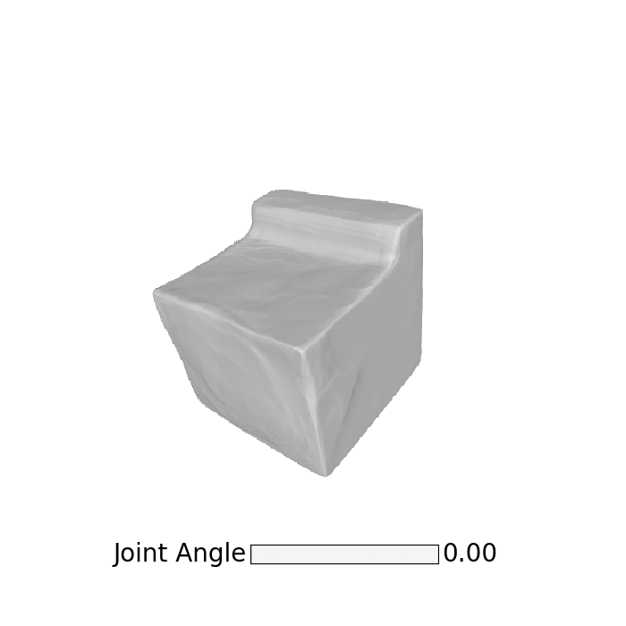
Input
Generation
Washing Machine

Slide 10
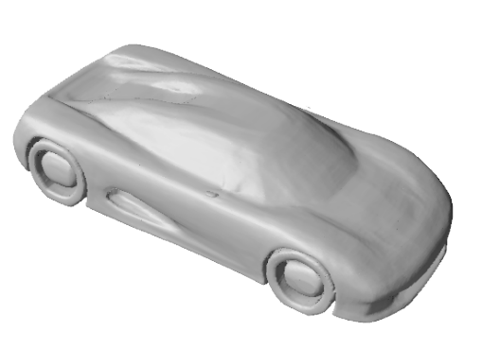
Related work
Rigid object reconstruction
Park et al., CVPR 2019
Mescheder et al. CVPR 2019
+ 3D
+ Category-level
- Articulated

Slide 11
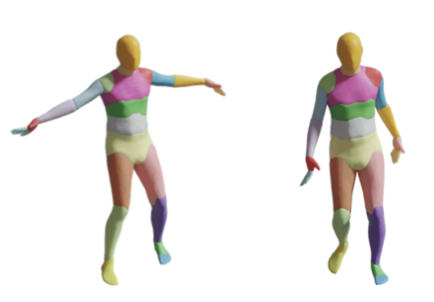
Related work
Rigid object reconstruction
Park et al., CVPR 2019
Mescheder et al. CVPR 2019
Articulated humans
Deng et al., ECCV 2020
+ 3D
+ Category-level
- Articulated
+ 3D
- Category-level
+ Articulated

Slide 12
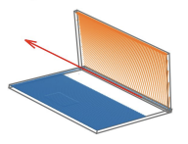
Related work
Rigid object reconstruction
Park et al., CVPR 2019
Mescheder et al. CVPR 2019
Articulated humans
Deng et al., ECCV 2020
6D pose estimation
Li et al., CVPR 2020
+ 3D
+ Category-level
- Articulated
+ 3D
- Category-level
+ Articulated
- 3D
+ Category-level
+ Articulated

Slide 13
Related work
Rigid object reconstruction
Park et al., CVPR 2019
Mescheder et al. CVPR 2019
Articulated humans
Deng et al., ECCV 2020
6D pose estimation
Li et al., CVPR 2020
Ours
+ 3D
+ Category-level
- Articulated
+ 3D
- Category-level
+ Articulated
- 3D
+ Category-level
+ Articulated
+ 3D
+ Category-level
+ Articulated

Slide 14
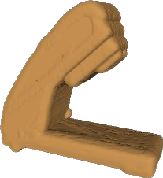
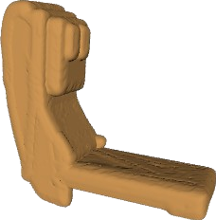
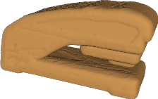
Our key idea: disentangled shape and articulation space
Shape code sharing
Separate shape and articulation codes
Shape Code
Sampled Point
SDF
(x,y,z)
MLP

Slide 15
Our key idea: disentangled shape and articulation space
Shape code sharing
Separate shape and articulation codes
Shape Code
Sampled Point
SDF
(x,y,z)
MLP
Articulation Code
90°
45°
0°

Slide 16


Our method: shape code sharing
Code sharing for all shapes articulated from the same instance, regardless of its articulation.
Input
Shape Code
Sampled Point

Slide 17
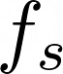
Our method: shape code sharing
Code sharing for all shapes articulated from the same instance, regardless of its articulation.
Input
Shape Embedding Net
Shape Code
MLP
Shape
Embedding
Sampled Point

Slide 18
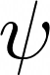
Our method: articulation modeling
Introducing the joint angles to model articulation.
Input
Shape Embedding Net
Shape Code
MLP
Shape
Embedding
Sampled Point
Fc layer
Articulation Code
Articulation
Embedding
90°
45°
0°

Slide 19
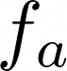
Our method: articulation modeling
Introducing the joint angles to model articulation.
Input
Output
Shape Embedding Net
Articulation Net
SDF Values
Shape Code
MLP
Shape
Embedding
MLP
Sampled Point
Fc layer
Articulation Code
Articulation
Embedding
90°
45°
0°

Slide 20
Our method: articulation modeling
Introducing the joint angles to model articulation.
Input
Articulated Signed Distance Function
Output
Shape Embedding Net
Articulation Net
SDF Values
Shape Code
MLP
Shape
Embedding
MLP
Sampled Point
Fc layer
Articulation Code
Articulation
Embedding
90°
45°
0°
Notes:
We name the combination of the shape embedding network and articulation network as our articulated signed distance function f_theta.

Slide 21
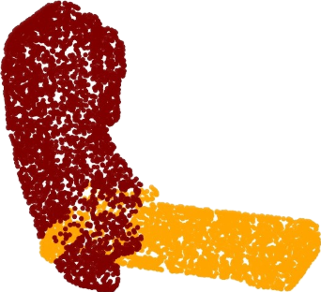
Our method: articulation modeling
Optionally, predict part labels if part labels are provided.
Input
Articulated Signed Distance Function
Output
Shape Embedding Net
Articulation Net
SDF Values
Shape Code
MLP
Shape
Embedding
MLP
Sampled Point
Part Labels (Optional)
Fc layer
Articulation Code
Articulation
Embedding
90°
45°
0°

Slide 22
Our method: overall architecture
Shape code and articulation signed distance function are jointly optimized during training.
Input
Articulated Signed Distance Function
Output
Shape Embedding Net
Articulation Net
SDF Values
Shape Code
MLP
Shape
Embedding
MLP
Sampled Point
Part Labels (Optional)
Fc layer
Articulation Code
Articulation
Embedding
90°
45°
0°

Slide 23
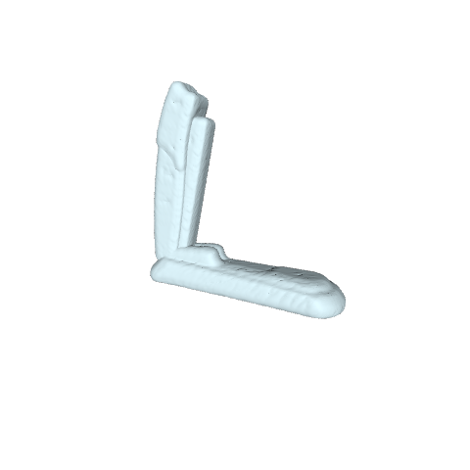
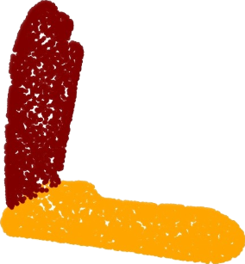
Inference: infer both shape and articulation codes
Given one observed shape, using back-propagation to infer its shape code and articulation code.
Articulated Signed Distance Function
Test Instance
Shape Embedding Net
Articulation Net
Inferred Shape Codes
MLP
Shape
Embedding
MLP
Part Labels (Optional)
Fc layer
Inferred Joint Angles
Articulation
Embedding

Slide 24

Inference: test-time adaptation for generalization
Test-time adaptation of the shape embedding net to better fit the observed shape.
Articulated Signed Distance Function
Test Instance
Shape Embedding Net
Articulation Net
Inferred Shape Codes
MLP
Shape
Embedding
MLP
Part Labels (Optional)
Fc layer
Inferred Joint Angles
Articulation
Embedding

Slide 25
Inference: test-time adaptation for generalization
Test-time adaptation of the shape embedding net to better fit the observed shape.
Articulated Signed Distance Function
Test Instance
Shape Embedding Net
Articulation Net
Inferred Shape Codes
MLP
Shape
Embedding
MLP
Part Labels (Optional)
Fc layer
Inferred Joint Angles
Articulation
Embedding

Slide 26
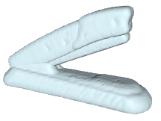
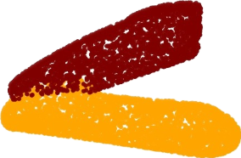
Shape generation at unseen articulation
Fix the inferred shape code and articulated signed distance function, input unseen articulation to generate new shapes.
Articulated Signed Distance Function
Generated Shape
Shape Embedding Net
Articulation Net
Inferred Shape Codes
MLP
Shape
Embedding
MLP
Part Labels (Optional)
Fc layer
Unseen Articulation
Articulation
Embedding

Slide 27
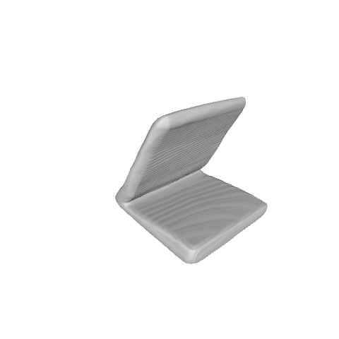
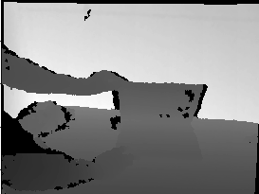
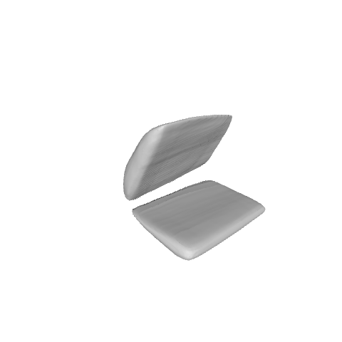
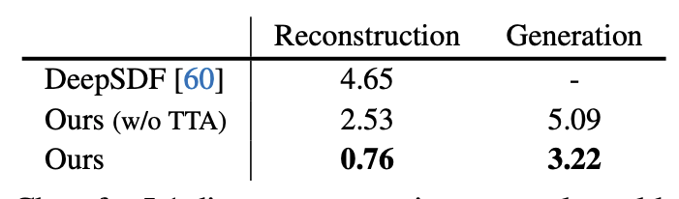
Experiment: test on real-world depth images
Our method reconstructs faithful shapes and allows for generating shapes at unseen articulations.
Reconstruction
Single Depth Image
Ours
DeepSDF

Slide 28
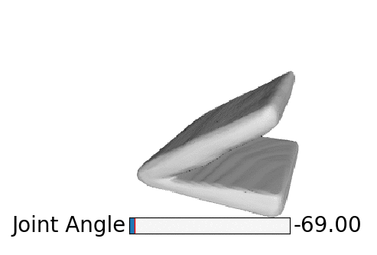
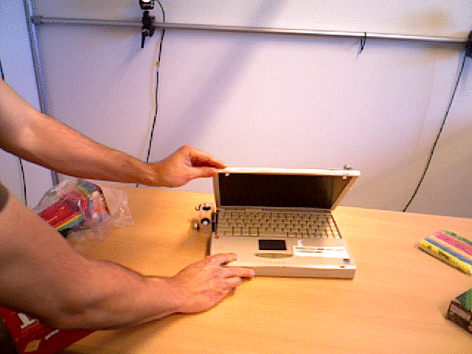
Experiment: test on real-world depth images
Our method reconstructs faithful shapes and allows for generating shapes at unseen articulations.
Reconstruction
Generated Laptops
Corresponding Images
(Not Input)
Single Depth Image
Ours
DeepSDF

Slide 29








Experiment: test on partial point clouds
Our method recovers valid 3D shape from observed partial point clouds.
Input Partial Point Cloud
Ours
DeepSDF
Ground-truth

Slide 30

Experiment: test on partial point clouds
Our method recovers valid 3D shape from observed partial point clouds.
Input Partial Point Cloud
Ours
DeepSDF
Ground-truth

Slide 31








Experiment: interpolation
Interpolated shapes by DeepSDF show unrealistic deformation, whereas our method faithfully interpolates shapes in between.
Inputs
DeepSDF
Ours

Slide 32
Conclusions
Propose Articulated Signed Distance Functions (A-SDF) to model daily articulated objects.
Ability to animate shapes.
Strong reconstruction, interpolation and extrapolation results.
More interestingly, our model can generalize to real-world depth images.

Slide 33
Thanks!
Project Page: https://jitengmu.github.io/A-SDF/

